Slide 1

Lecture no: 10 Outlier Detection

Slide 2
WHAT IS OUTLIERS:
Outliers are data points that significantly differ from other observations in a dataset. These data points are often referred to as anomalies or extreme values and do not conform to the general pattern or behavior of the rest of the data.

Slide 3
TYPES OF OUTLIERS:
In a dataset, outliers can manifest in different ways:
Univariate Outliers: These outliers occur when a single variable has extreme values compared to the rest of the dataset. For example, in a dataset of student heights, an outlier could be a student who is much taller or shorter than the majority of the students.
Multivariate Outliers: These outliers occur when a combination of multiple variables is considered. They may not be considered outliers when looking at individual variables, but when considering their joint distribution, they exhibit extreme behavior. For example, in a dataset of housing prices, a house may have an unusually high price for its size and location.

Slide 4
Techniques to detect outliers:
Using Dtale Library Describe Feature
Using Scatter Plot
Using Histogram Plot
Using Box Plot
Using Z-score index
Using IQR (Interquartile range) Range

Slide 5
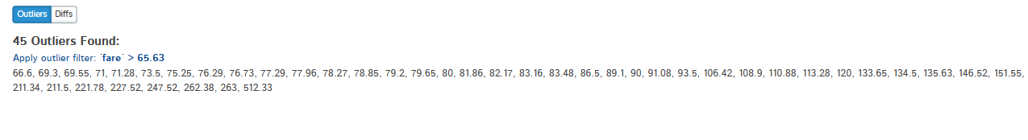
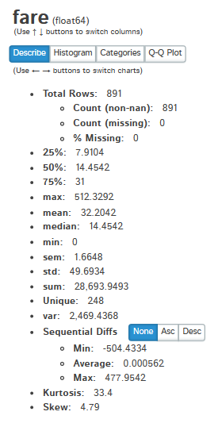
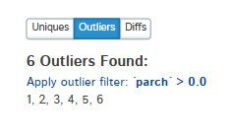
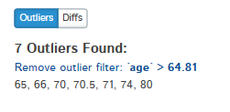
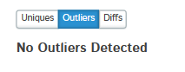
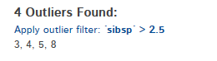
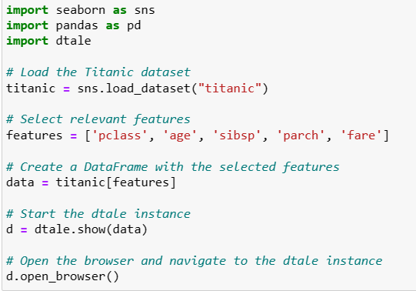
Using Dtale Library Describe Feature
Notes:
import seaborn as sns
import pandas as pd
import dtale
# Load the Titanic dataset
titanic = sns.load_dataset("titanic")
# Select relevant features
features = ['pclass', 'age', 'sibsp', 'parch', 'fare']
# Create a DataFrame with the selected features
data = titanic[features]
# Start the dtale instance
d = dtale.show(data)
# Open the browser and navigate to the dtale instance
d.open_browser()

Slide 6
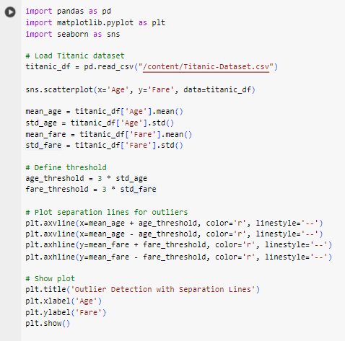
Using Scatter Plot

Slide 7
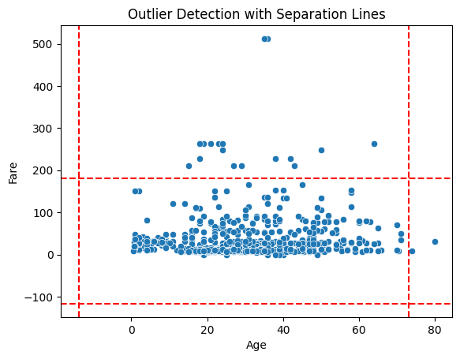
Output:
Visual Inspection: Take a close look at the scatter plot. Outliers will appear as points that are far away from the main cluster of data points. These could be passengers who paid unusually high fares or are unusually old or young.

Slide 8
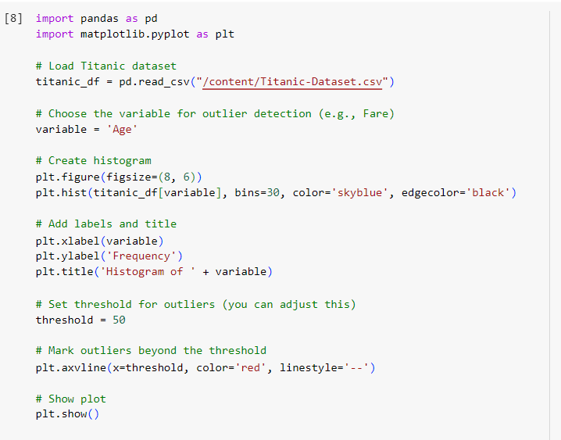
Using histogram:

Slide 9
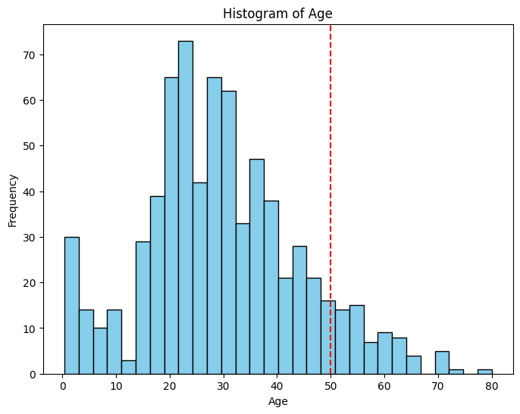
Output: how to inspect visually?
Visual Inspection: Examine the histogram for any unusually high or low values. Outliers may appear as bars that are significantly taller or shorter than the others. Or Examine the histogram to identify any outliers beyond the calculated threshold.

Slide 10
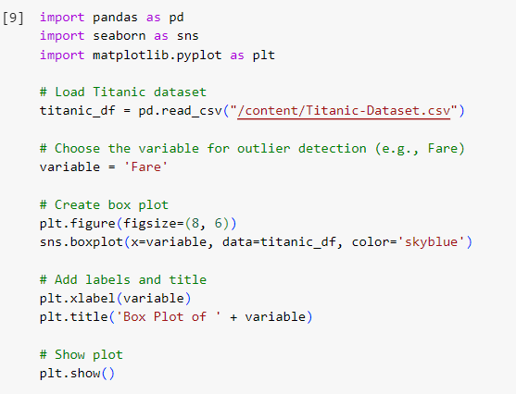
Box plot

Slide 11
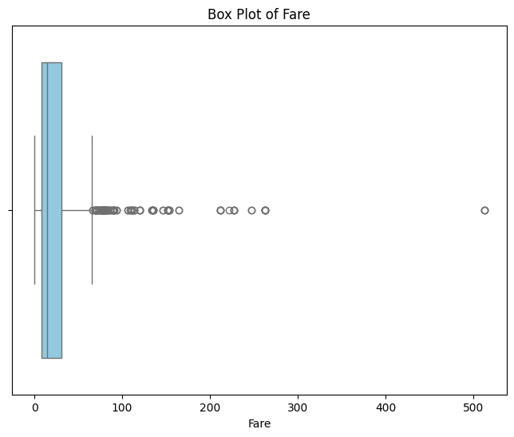
Output: how to inspect visually?
Visual Inspection: Examine the box plot for any data points that fall outside the whiskers (the lines extending from the box). These are typically considered outliers.

Slide 12
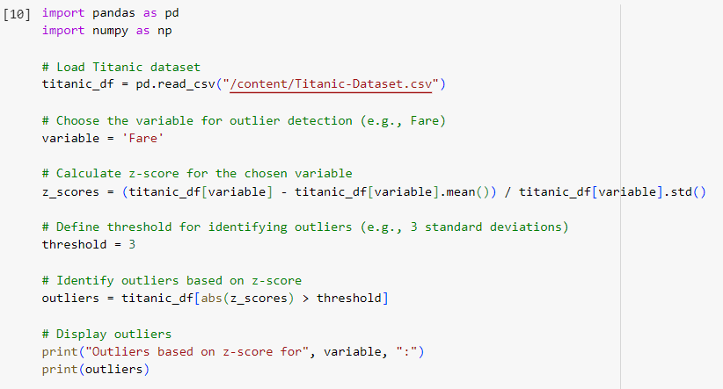
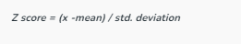
Using z-score

Slide 13
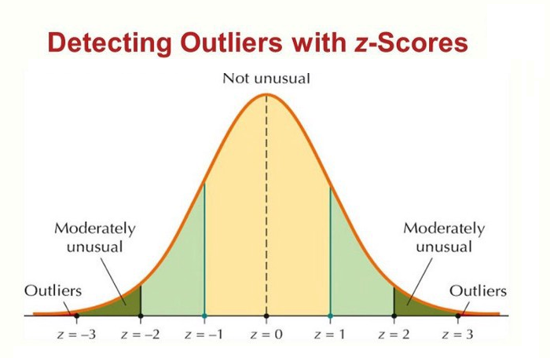
Illustration for z-score

Slide 14
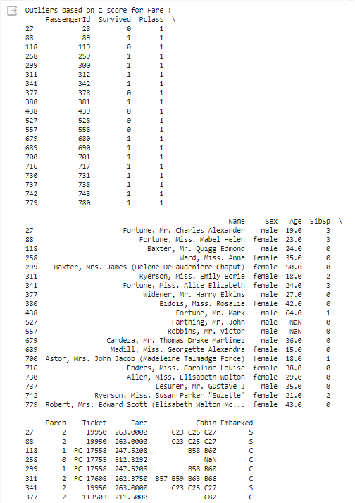
Output:

Slide 15
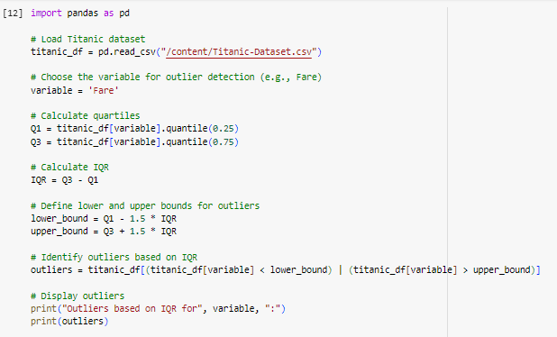
Using iqr range:
outliers are identified based on whether their values fall below the lower bound (Q1 - 1.5 * IQR) or above the upper bound (Q3 + 1.5 * IQR).

Slide 16
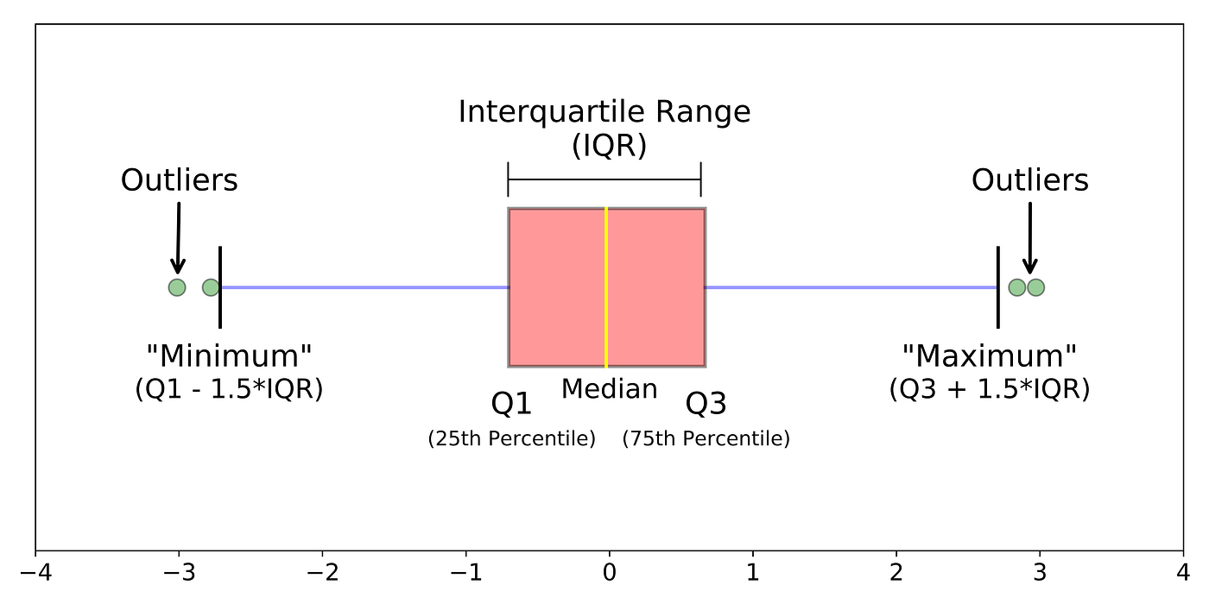
Illustration for iqr

Slide 17
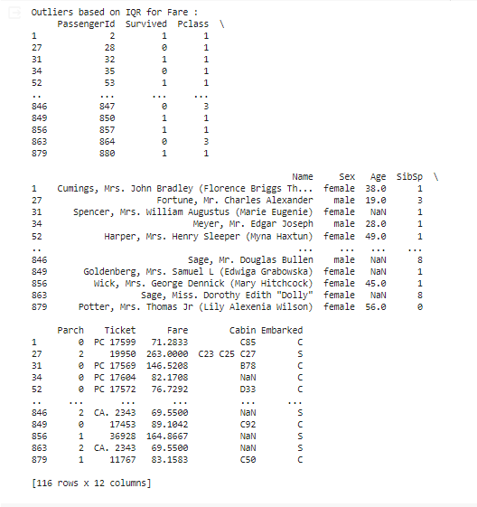
Output:

Slide 18
Techniques to handle outliers:
Trimming: Remove outliers by trimming the extreme values from the dataset. This approach involves removing data points beyond a certain threshold.
Winsorization: Replace outliers with the nearest non-outlier value. This technique helps mitigate the impact of outliers without completely removing them.
Mean/Median Imputation: Replace outliers with the mean or median of the variable. This approach helps preserve the overall distribution of the data while reducing the influence of outliers.
Use Robust Models: Choose machine learning algorithms that are inherently robust to outliers, such as decision trees, random forests, and support vector machines (SVM).

Slide 19
Tasks: Lab Tasks/Practical Work
1. An automotive company wants to identify and treat outliers in their "mtcars" dataset. which contains information about various car models. They suspect that certain car models might have outlier values in certain variables and want to analyze and handle them using Python.
Perform the following outlier detection techniques.
Box Plot
Z-score
IQR range
Scatter

Slide 20
Tasks: Lab Tasks/Practical Work
2. An automotive company has identified outliers in their "mtcars" dataset and wants to treat them to ensure accurate analysis and modeling. They want to detect and handle the outliers using Python. Performed the techniques that provided in the lab to treat the outliers

